Slide 1
Movie review prediction using twitter data.
Done By:
Ravi Teja Kakara
Prasanth Chakravarthy Gajula
Manideep Ramineni
Ratna Manikanta Ajay Kumar Kakarala
Sri Satya Praveen Gatti
Ramireddy Singareddy

Slide 2
Table of Contents
Overview
Architecture
Technology Stack
Data Collection
Web Scraping
Tweets Extraction
Data Preprocessing
Sentiment Analysis
Data Visualization
Overview of Web Page

Slide 3
Overview
Social Media has been a part of human lives and people are expressing their opinions, support, likes and dislikes through the digital platforms like Twitter, Facebook, Instagram, etc.
Movies are undoubtedly one of the best entertainments. And many people glance at the movie reviews and decide whether to watch a movie or not.
So, we thought of using Twitter, where millions of people express their views. We are collecting their views and predicting the review of the movie.
Prediction of movie review by analysing user sentiments expressed through tweets on the Twitter platform. This is done by classifying tweets into positive, negative, and neutral responses. Finally, we predict the sentiment using the tweets and visualize the data based on different aspects such as region, trend of movie over a period of time.

Slide 4
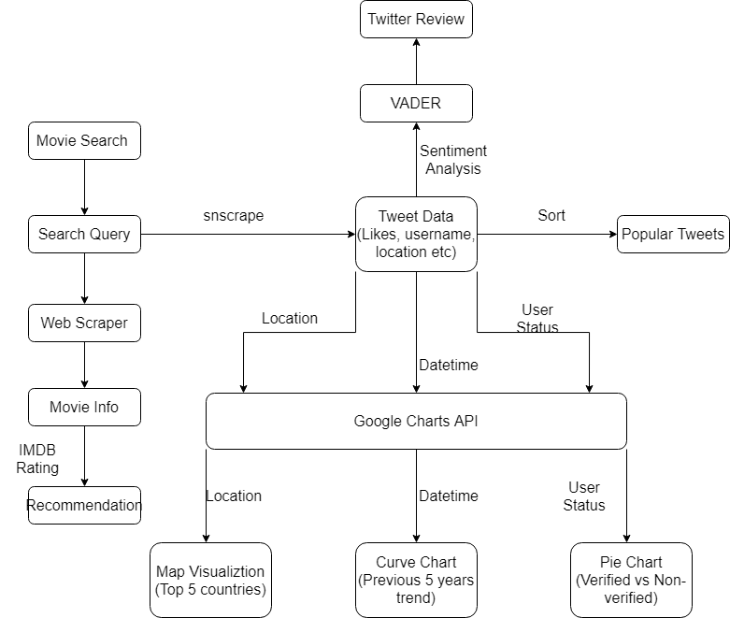
Architecture

Slide 5
Technology Stack
Web Scraping | Requests, bs4 (beautiful Soup)
Tweets Extraction | snscrape, pandas
Sentiment Analysis | Nltk, VADER
Data Visualization | Google charts API, pycountry
Back-end | Python
Front-end | Html, CSS
Framework | Django

Slide 6
Data Collection
Web Scraping:
Using web scraping, we collect various data regarding the movie and display it on the web page.
Tweets Extraction:
Tweets related to the movie are extracted from twitter in real time and perform Sentiment Analysis on the data to know the opinion of people on the movie.

Slide 7
Web Scraping
requests :
requests is a python HTTP library. It adds query strings to the URLs and downloads the HTML page at that URL.
bs4:
Bs4 popularly known as beautiful soup is a python package that prevents name squatting.

Slide 8
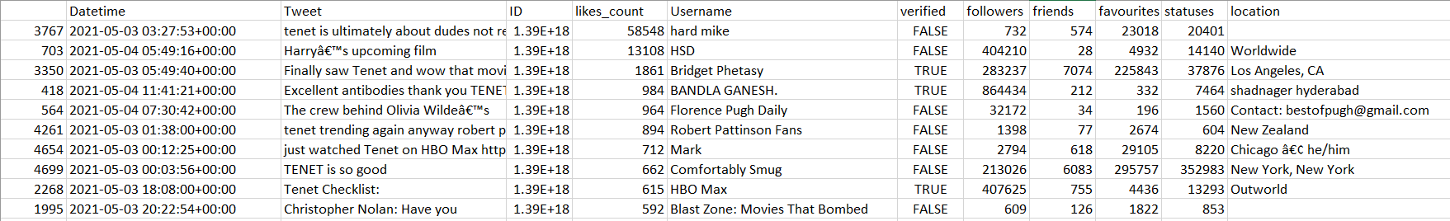
Tweets Extraction
snscrape:
snscrape is a scraper for social networking services.
Tweets related to the movie are scraped over twitter using the snscrape.

Slide 9
DataPrepocessing
We performed the following Data preprocessing on the obtained Twitter Data.
Sorting of dataset based on likes-count.
Handling of Null Values.
Time deletion in Date-Time field of the dataset.
bs4

Slide 10
Sentiment Analysis
VADER (Valence Aware Dictionary and Sentiment Reasoner):
It is a lexicon and rule-based sentiment analysis tool that is specifically suited for sentiments expressed in social media
A sentiment lexicon is a list of lexical features, in simpler terms, words which are generally labeled according to their semantic orientation as positive, negative, or neutral.
OUTPUT-{'neg': 0.0, 'neu': 0.508, 'pos': 0.492, 'compound': 0.4404}

Slide 11
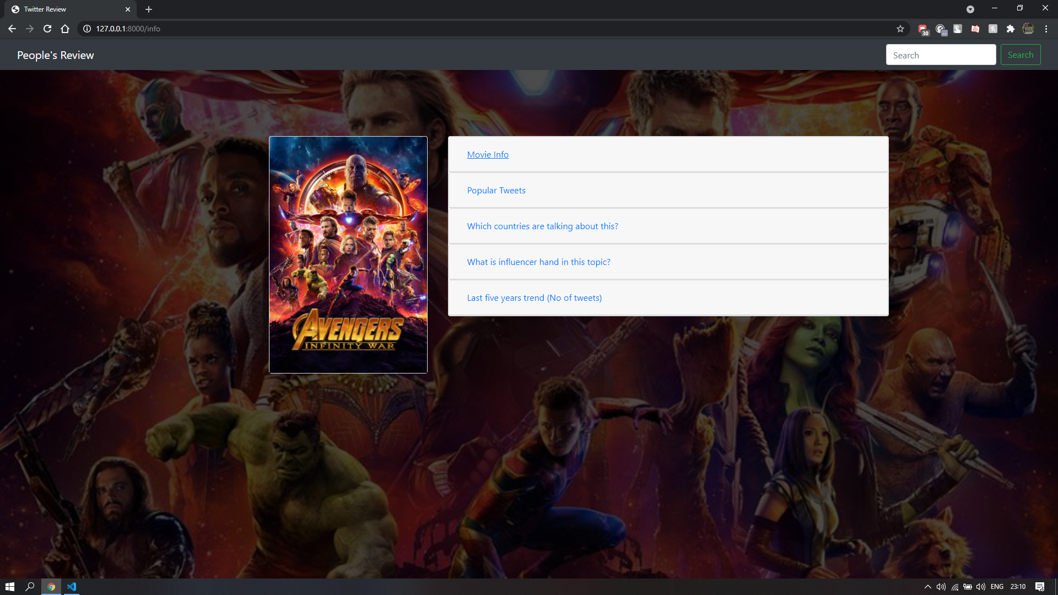
Overview of the Web Page

Slide 12
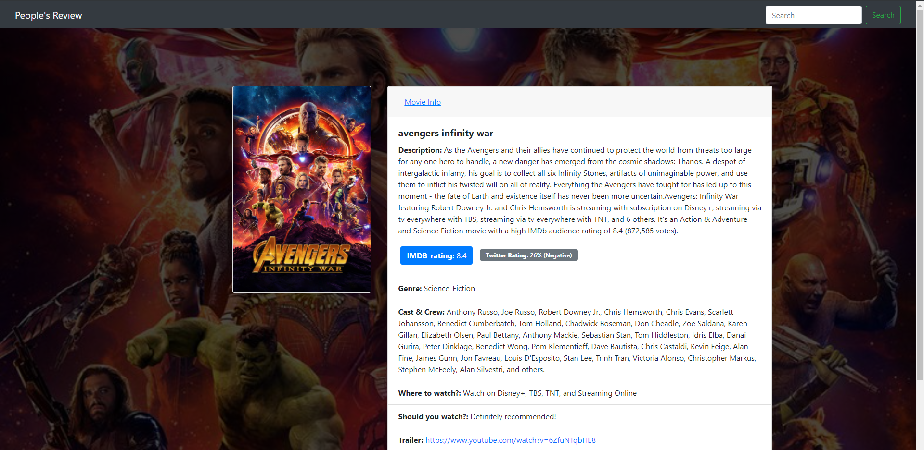
Movie Description

Slide 13
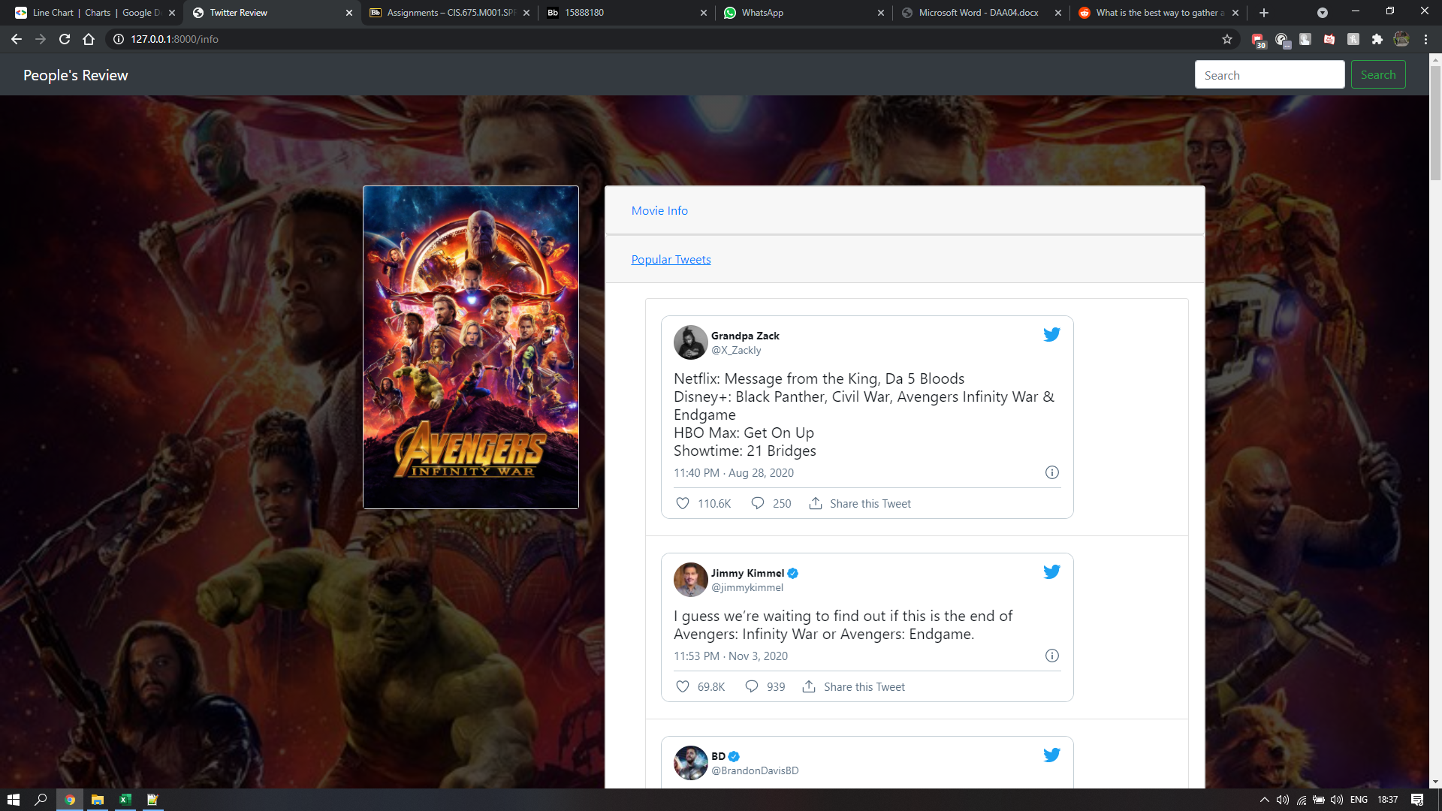
Top 10 Tweets

Slide 14
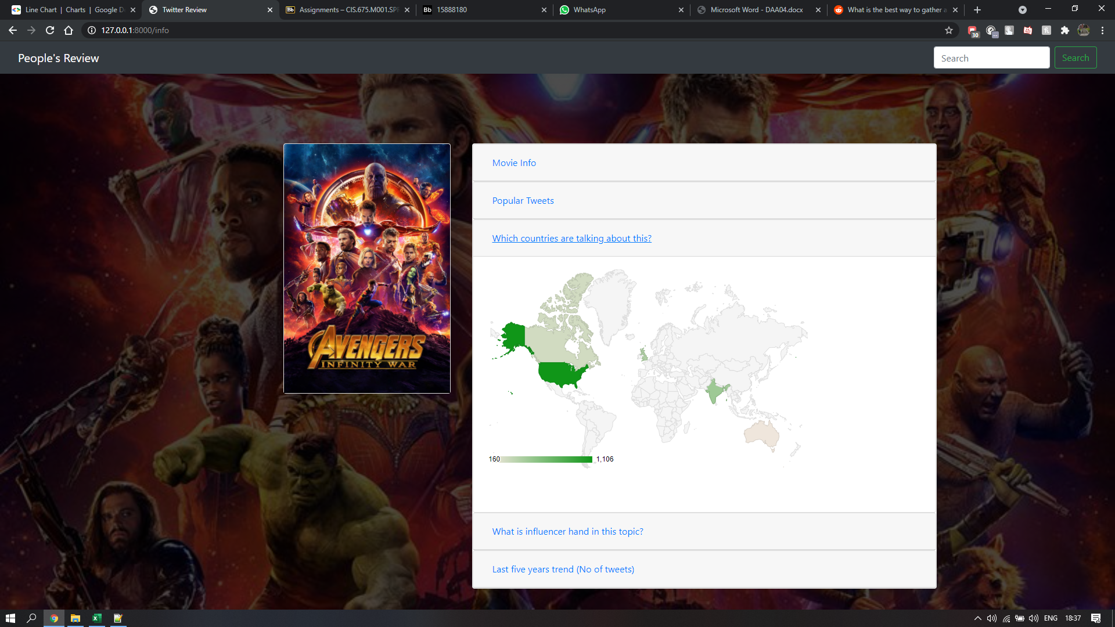
Geo Chart

Slide 15
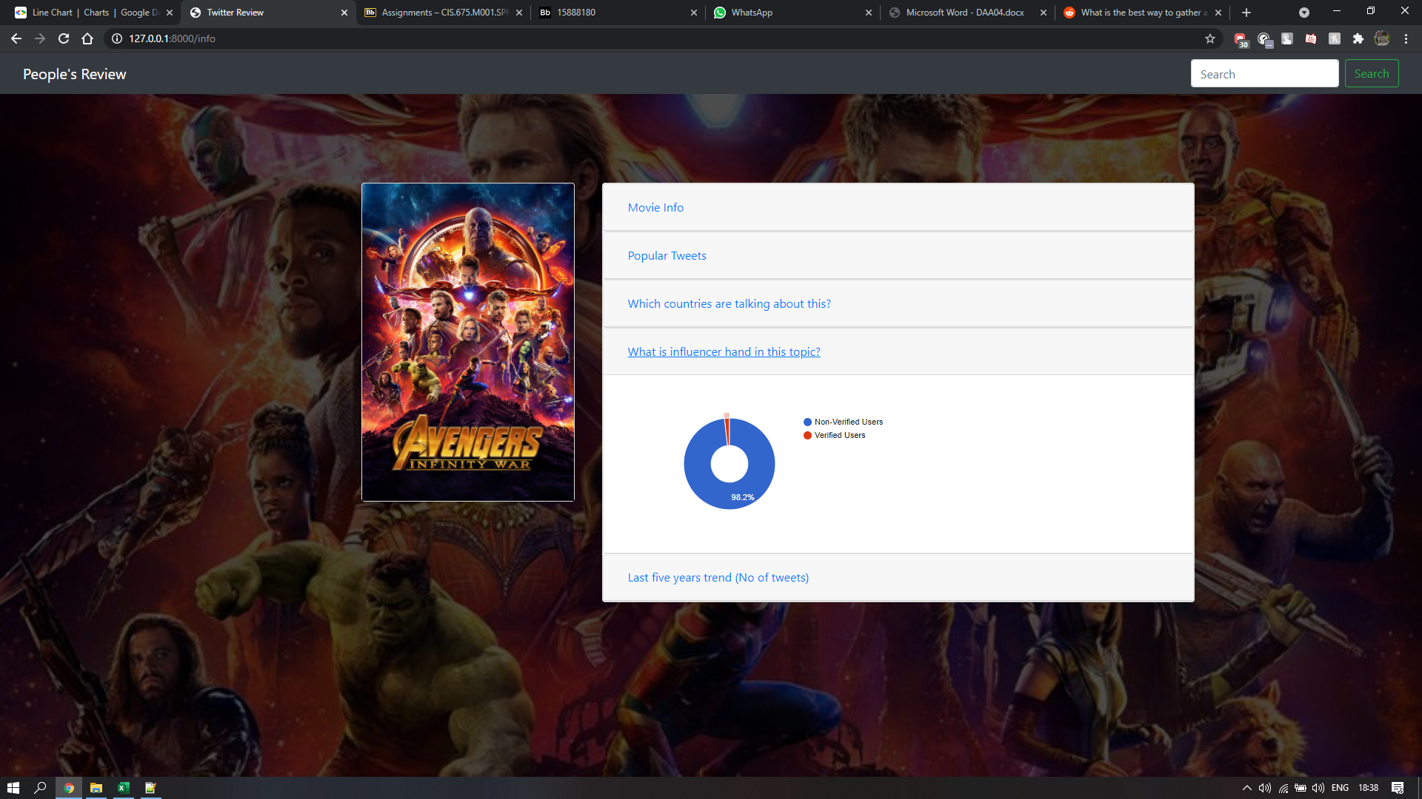
Verified and unverified users.

Slide 16
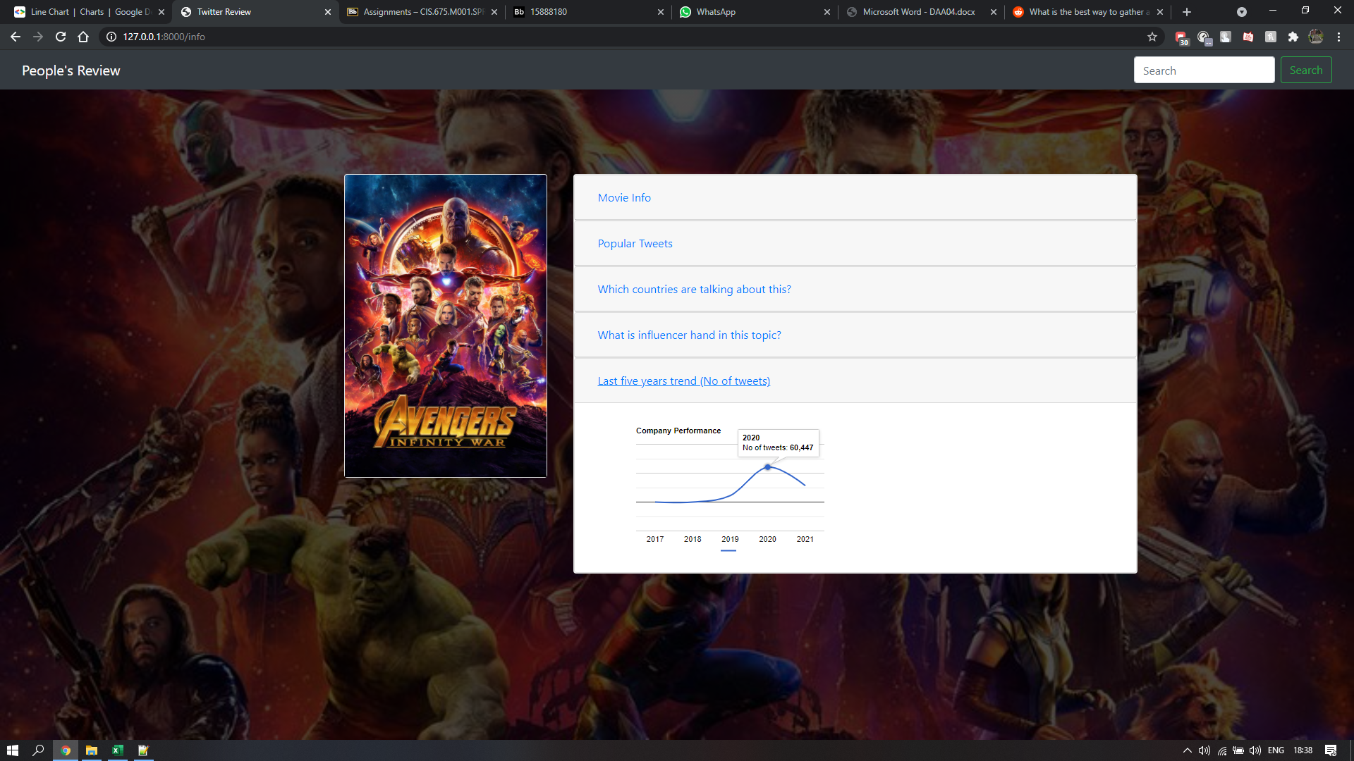
Trend of tweets regarding the movie over a period of time.

Slide 17
Thank you!

